Slide 1
Autodesk Technical Sales Vault-Job-Collection
Work in Progress
Solution Samples
Markus Koechl
Solutions Engineer PDM|PLM

Slide 2
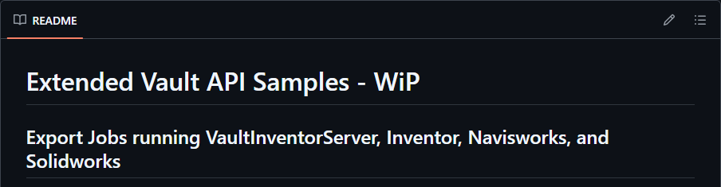
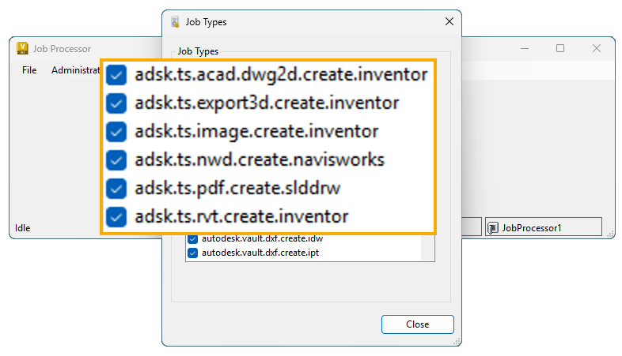
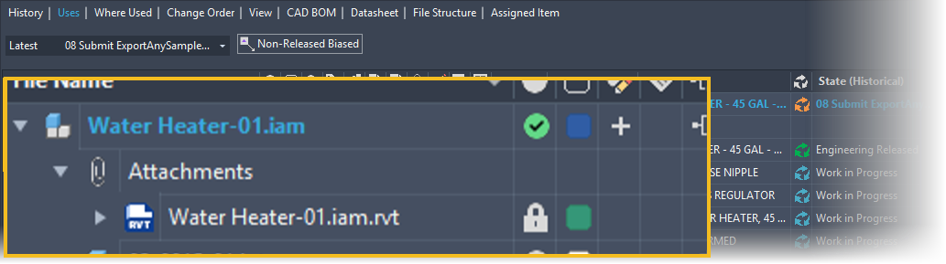
Overview
TS Vault Job Collection
Replaced “InventorExportAnySampleJob”
.NET Core – complete rewrite
Distinct Jobs per task/acting application
Individual job option configuration
Enable/disable as needed
Shared library for common functions like acquiring files or handling export files

Slide 3

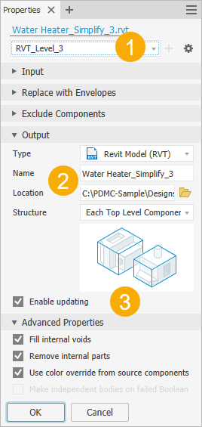
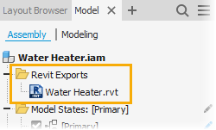
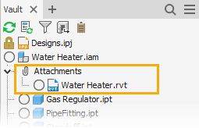
Revit Exports
Inventor Automation – Vault Integrated
Objectives and Scope
The Inventor Simplification workflow for Revit (*.rvt) targets Autodesk Docs for sharing
Leverage preset simplification levels to publish models for Forma sharing or collaboration processes
Outcome Options | Benefits
Automate the simplification process
Leverage simplification presets (managed by Vault)
Create/Update vaulted RVT Export files
Auto check-out/check-in
Manage RVT export files as Vault Attachment
Automate all steps required to share Revit project files for on-premise and cloud collaboration

Slide 4
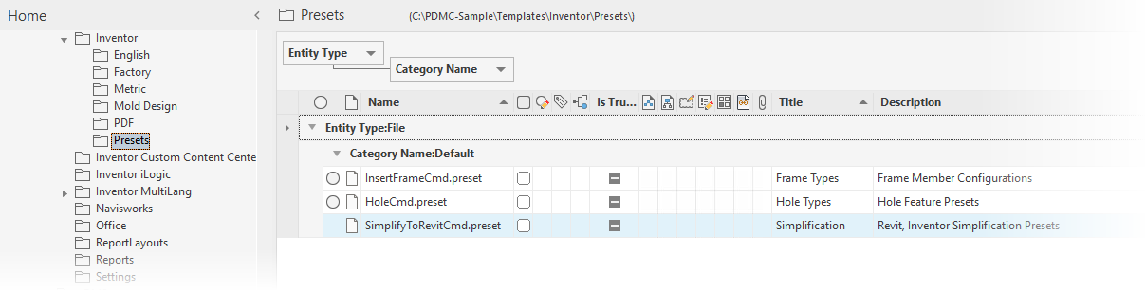
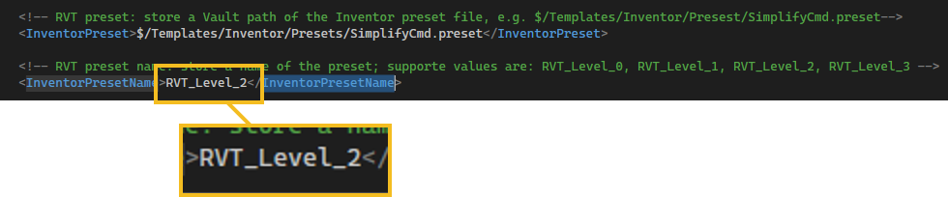
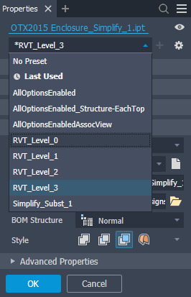
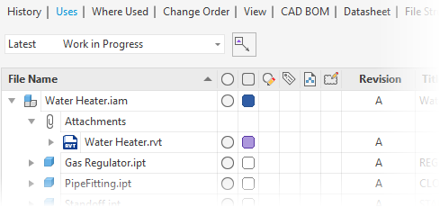
Revit Exports
Pre-requisites Inventor Model
Assembly context
Simplification preset file
Managed in Vault
Containing 1 to 4 simplification levels
Result
Simplified geometry saved as Revit file
Export files added/version updated
Location = source file’s location
Known limitation
Export files are attached if FDU DWG underlays are not active
Export files are not attached in FDU environments with active DWG underlays
Inventor-Revit Automation – Vault integrated

Slide 5
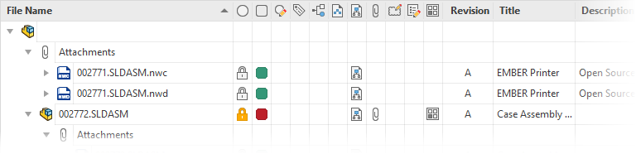
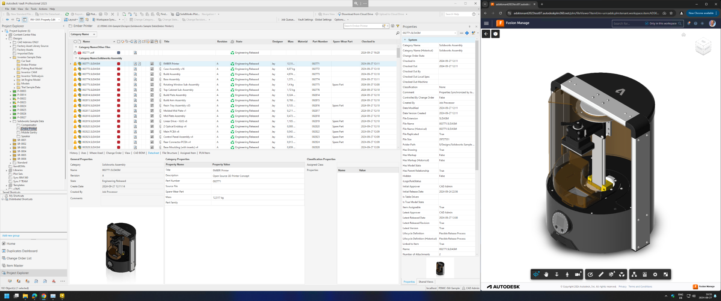
Navisworks – Import AnyCAD
Challenges
Vault has supported Inventor AnyCAD workflows for a while. However, these third-party CAD formats or neutral 3D model formats aren’t viewable.
Default DWF creation in Inventor or Solidworks has limitations in support of large assemblies.
Solution
The Technical Sales Job sample collection added Navisworks Automation as a processor engine.
Navisworks Automation can be used to create Navisworks files with optimized support in Autodesk Viewer and also to create DWF visualization attachments for the Vault viewer

Slide 6
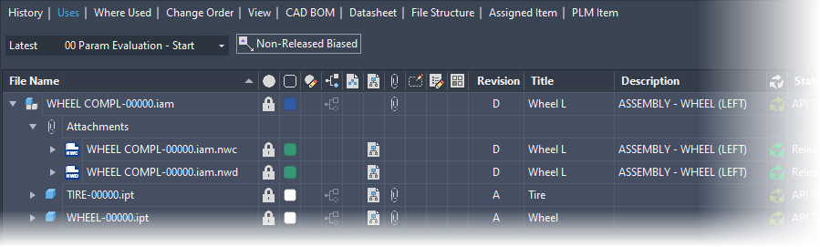
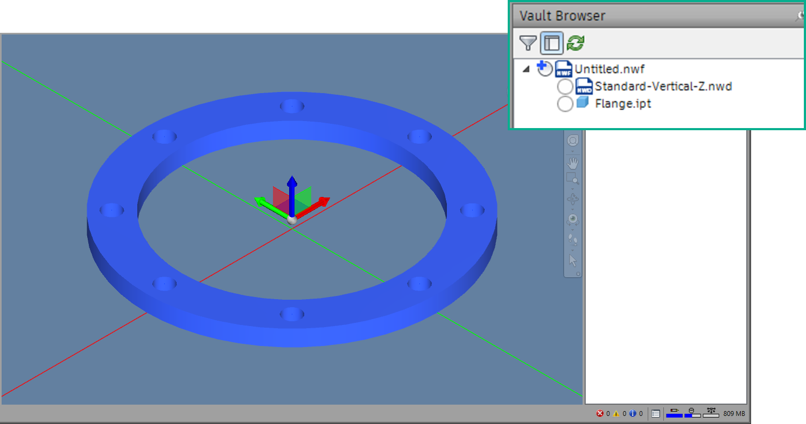
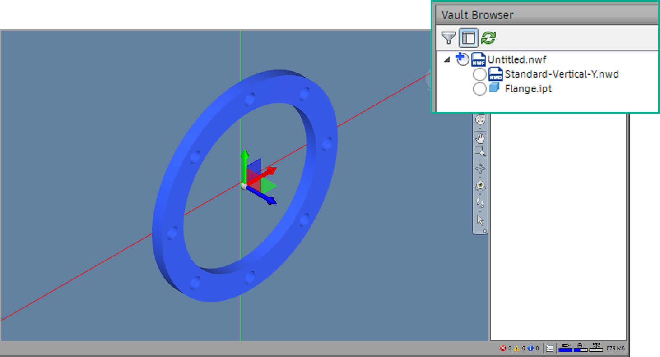
Navisworks Import Job
Create NWD and DWF for AnyCAD
Automates Navisworks Open/Append + Save As workflows
Requires Navisworks license to leverage the most reliable conversion that Navisworks SDK offers (compared to license-free command line options)
Leverage the superior performance of NWD files in Autodesk Viewer (all cloud platforms)
Consume Navisworks templates managed in Vault
Supports CAD source file property consumption

Slide 7

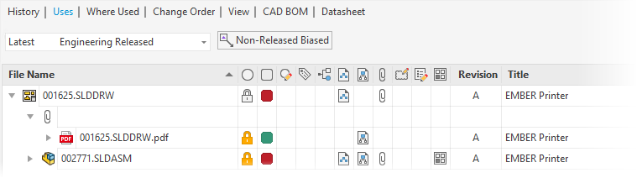
SolidWorks Drawing -> PDF
Technical Sales Extension | Sample Code
Challenges
The Vault for Solidworks Add-In creates DWF files for 3D models and 2D drawings. This “DWF-Printer” cannot technically support all features.
Most customers expect PDF as a design representation or viewing format for Solidworks drawings.
Solution
The Technical Sales Job extension “ExportAnySample” added native Solidworks Save As PDF for 2D drawings.
The PDF Design Representation files synchronize the revision index, and a matching “Released” state.

Slide 8
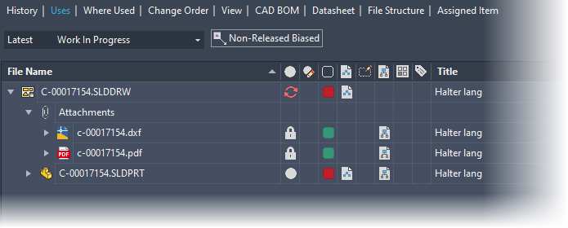
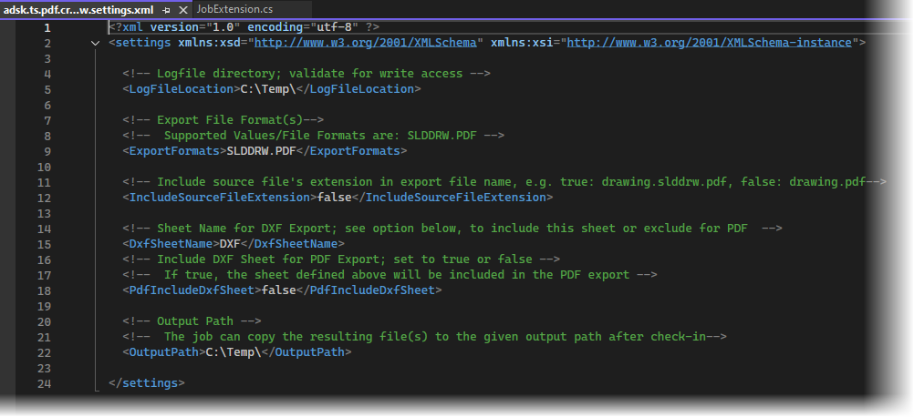
SolidWorks Drawing
PDF, DXF Export
PDF Export consumes job processor’s SolidWorks export options for PDF
Additional option to support common practice of splitting out Sheet Metal flat pattern documentation as DXF for laser cutting
Job iterates all drawing sheets
Add all sheets to PDF export file
Leverage configurable naming convention to exclude sheet metal flat pattern sheets
[Optional] Save sheet metal sheet as DXF file
Job leverages SolidWorks DXF export configuration including export *.ini file consumption

Slide 9
Download
Technical Sales Extension | Sample Code
Source Code | Documentation
GitHub
Source Code
Release – MSI Installers -> To be done
Documentation -> To be done

